Slide 1

LOGIC GATES

Slide 2

CONTENTS
Logic Gates
Truth table

Slide 3
What is a gate?
•
The building blocks used to create digital circuits are logic gates
Combination of transistors that performs binary logic
There are three elementary logic gates and a range of other simple gates
Each gate has its own logic symbol which allows complex functions to be represented by a logic diagram
The function of each gate can be represented by a truth table or using Boolean notation
•
•
•
•

Slide 4
LOGIC GATES
Types of gates
NOT
AND
OR
NAND
NOR
EX-OR
EX-NOR

Slide 5
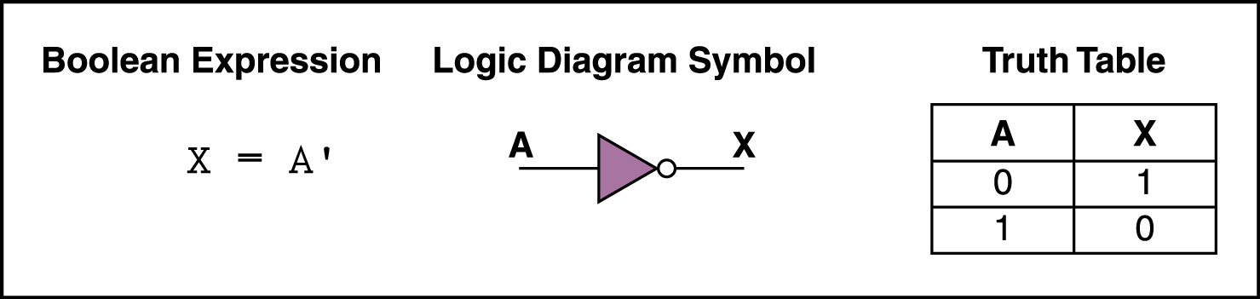
NOT Gate
•
A NOT gate accepts one input value and produces one output value
By definition, if the input value for a NOT gate is 0, the output value is 1, and if the input value is 1, the output is 0
A NOT gate is sometimes referred to as an inverter
because it inverts the input value
•
•

Slide 6
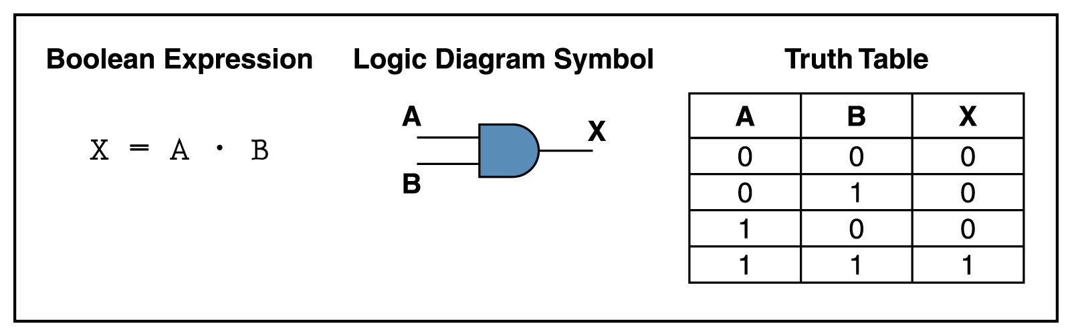
AND Gate
An AND gate accepts two input signals
If the two input values for an AND gate are both 1, the output is 1; otherwise, the output is 0

Slide 7
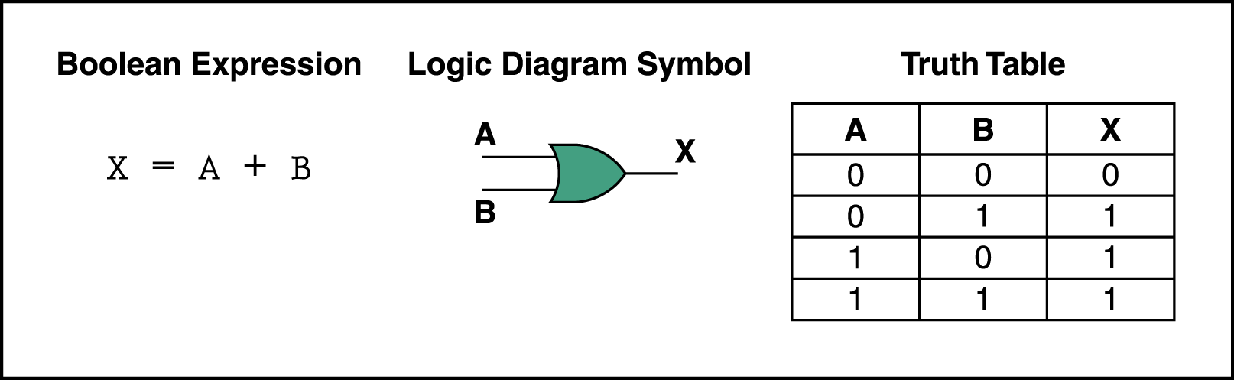
OR Gate
If the two input values are both 0, the output value is 0; otherwise, the output is 1

Slide 8
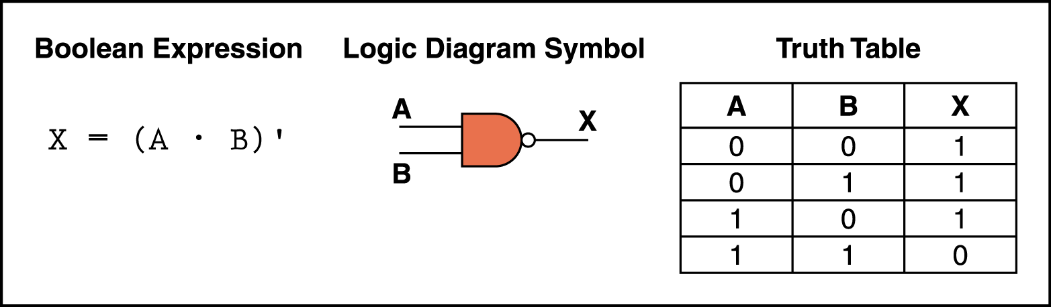
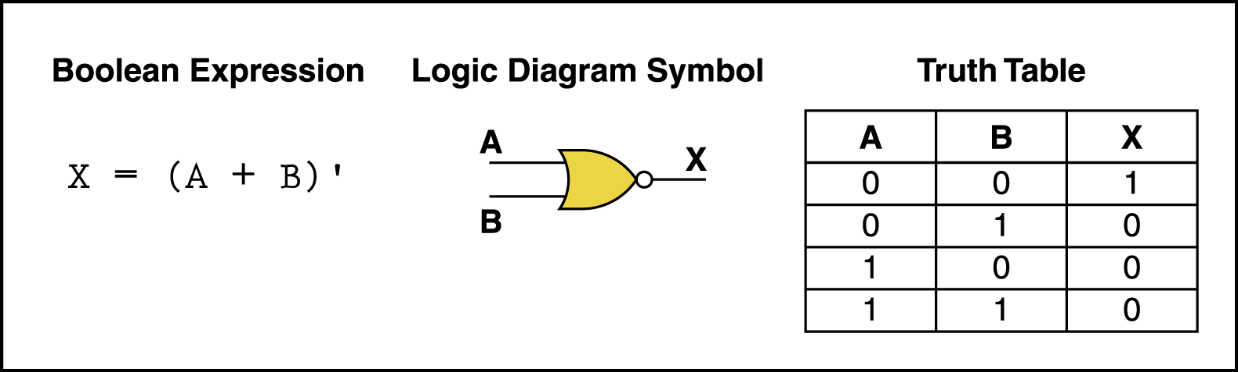
NAND and NOR Gates
The NAND and NOR gates are essentially the opposite of the AND and OR gates, respectively.
They are also called universal gates.

Slide 9
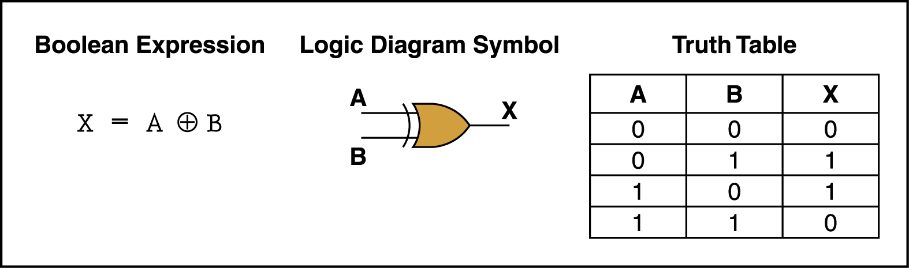
XOR Gate
XOR, or exclusive OR, gate
– An XOR gate produces 0 if its two inputs are the same, and a 1 otherwise

Slide 10
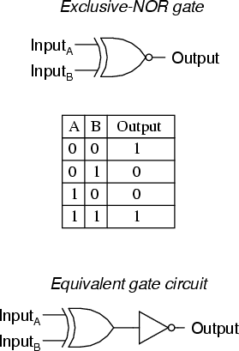
XNOR Gate
The exclusive-nor gate or xnor is logically equivalent to an xor gate followed by an inverter

